Slide 1
Digital Code lock System
Report submitted as a part of
MINI PROJECT I
TE - Electronics and Telecommunication Engineering
Semester V
By
Ms.Emily Esther Kurian
Mr.Mathew Thomas
Mr.Umang Mehta
Ms.Sakshi Mahesh

Slide 2
Problem Statement And Objective
To serve purpose of security
Access control system that allows authorized persons to access
Access control for doors forms a vital link in the security chain
To enable us to carry out secondary research for implementing digital security
To do away with physical mechanisms as they are subject to wear and tear

Slide 3
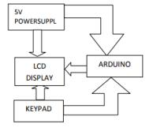
Block Diagram
The Arduino and the LCD will be energized using 5v power supply
Arduino uno, AVR RISC controller is used where the program for the project is written.
Microcontroller inside it will check whether the enter password is correct or not.
LCD will indicate whether access is granted or not
If wrong password is entered three times, the system will be locked. To unlock the system we have to reset the system.

Slide 4
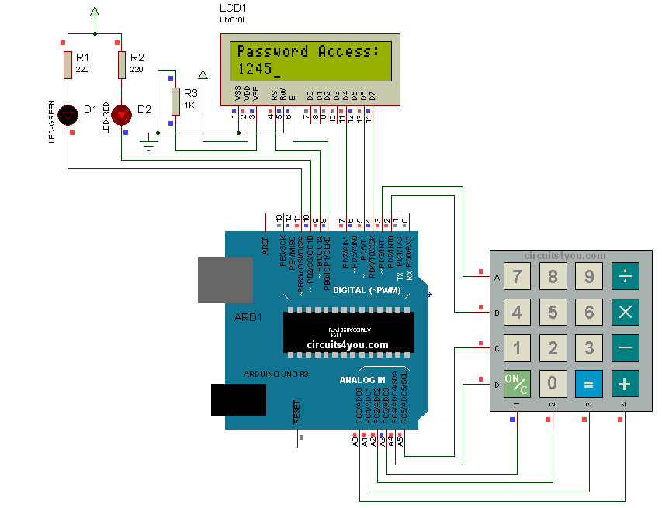
Hardware Used
Arduino UNO R3
Keypad Module
16x2 LCD
BC547 Transistor
Resistor (1k)
Bread board
Power
Connecting wires

Slide 5
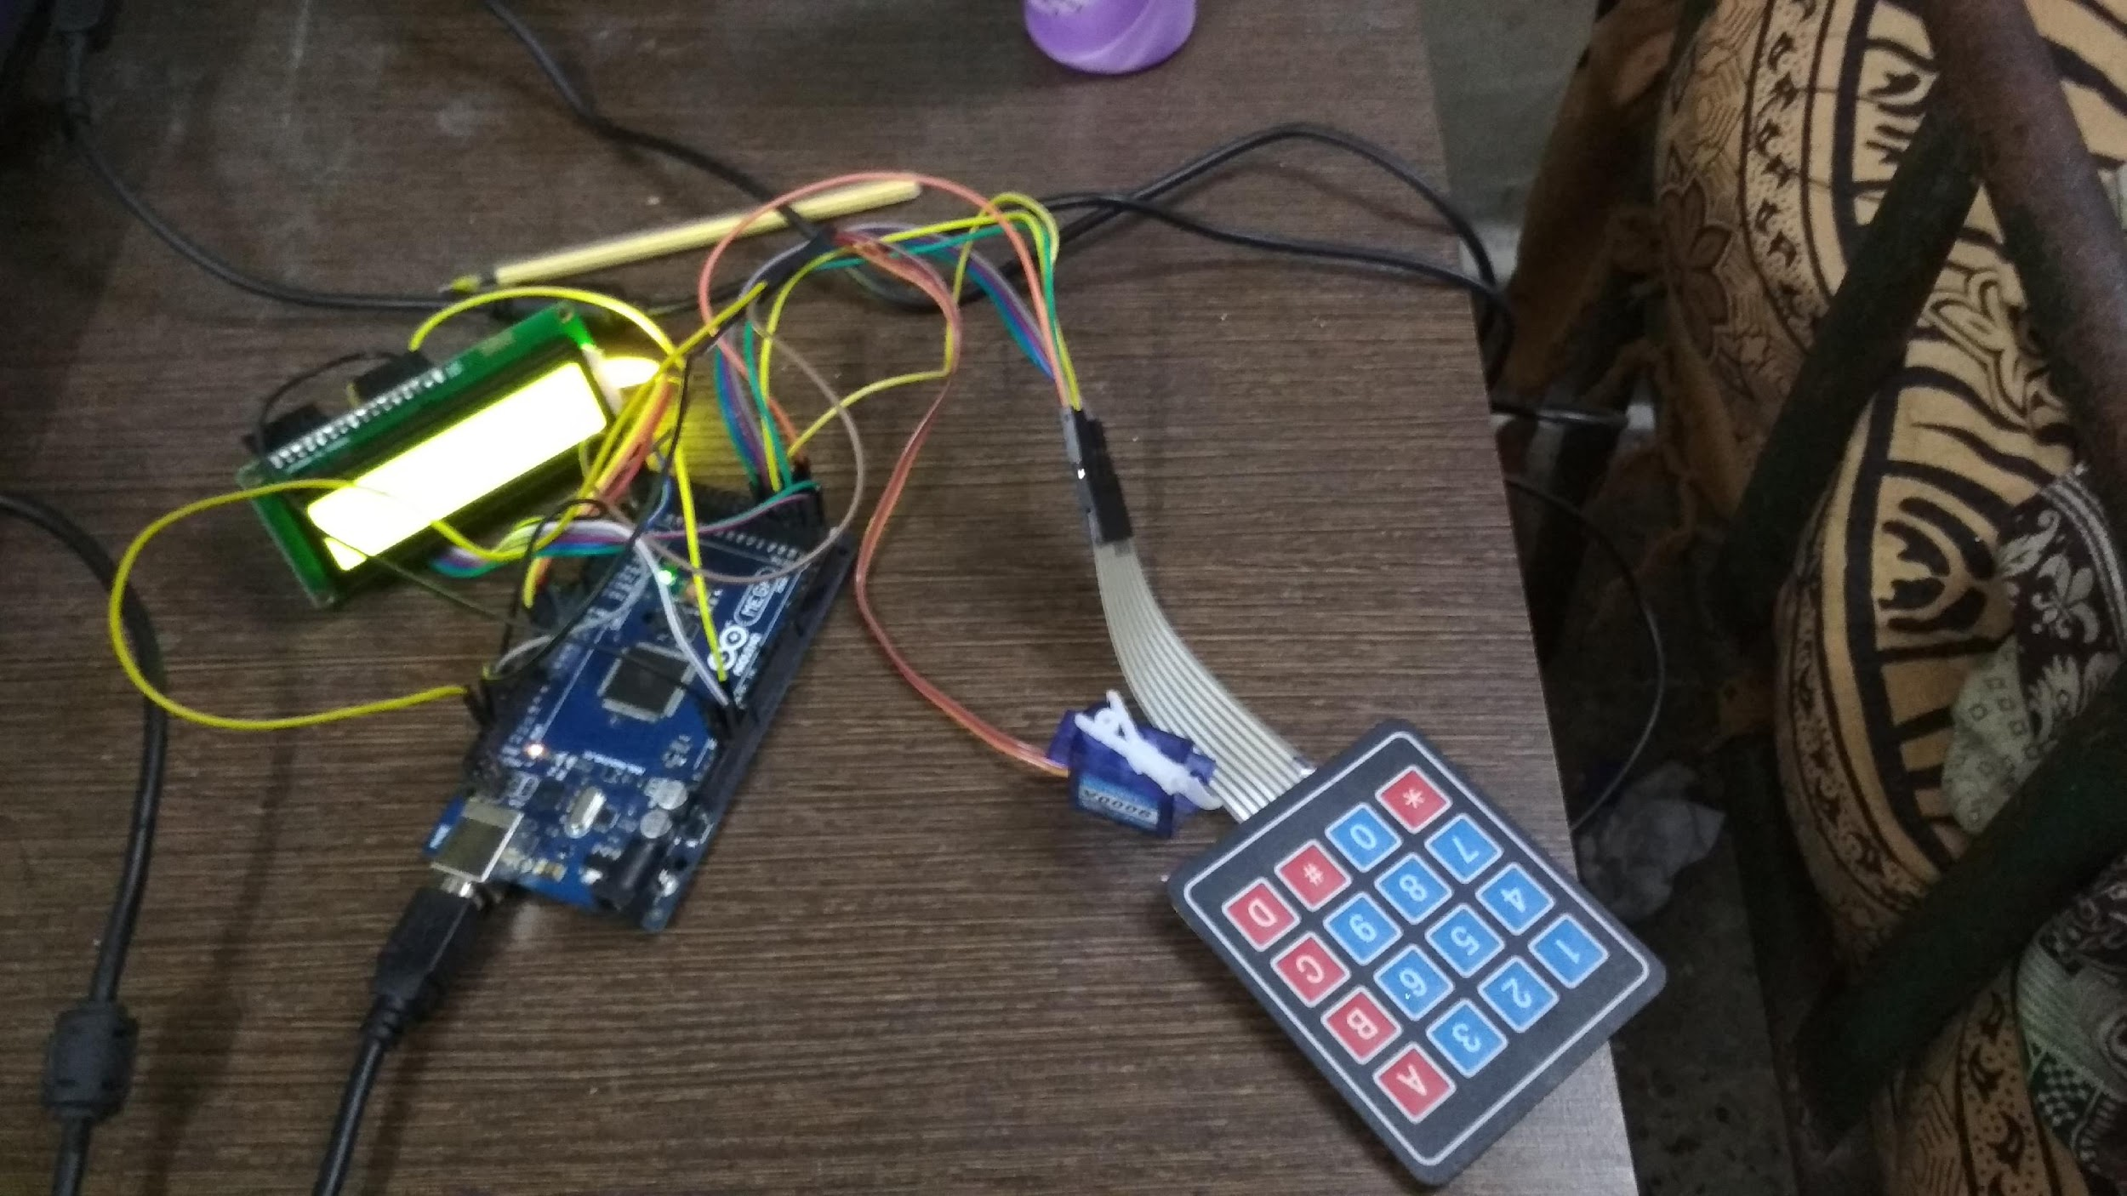
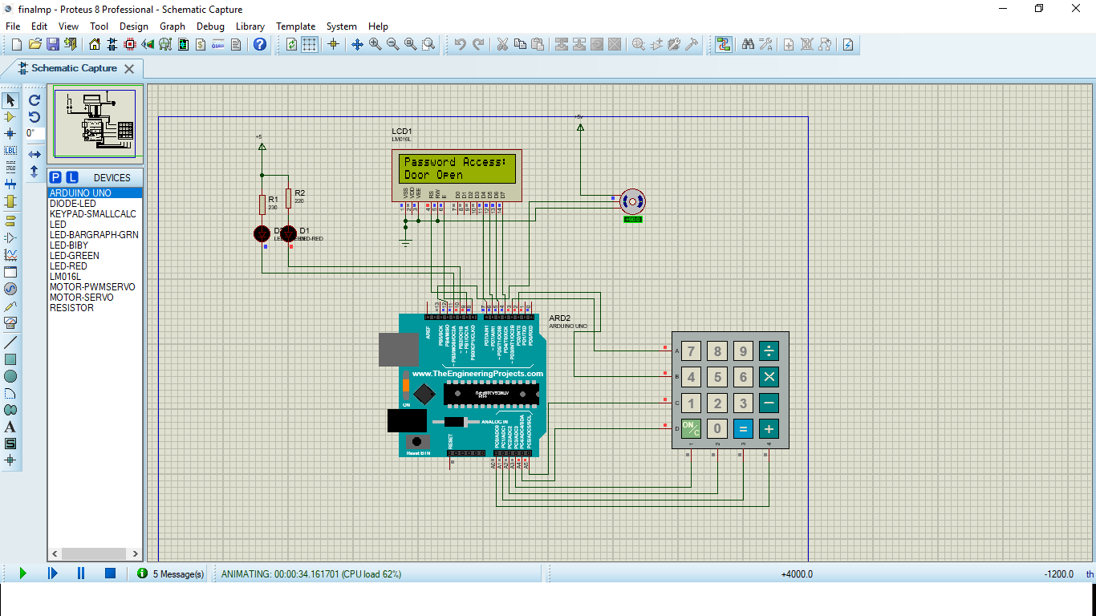
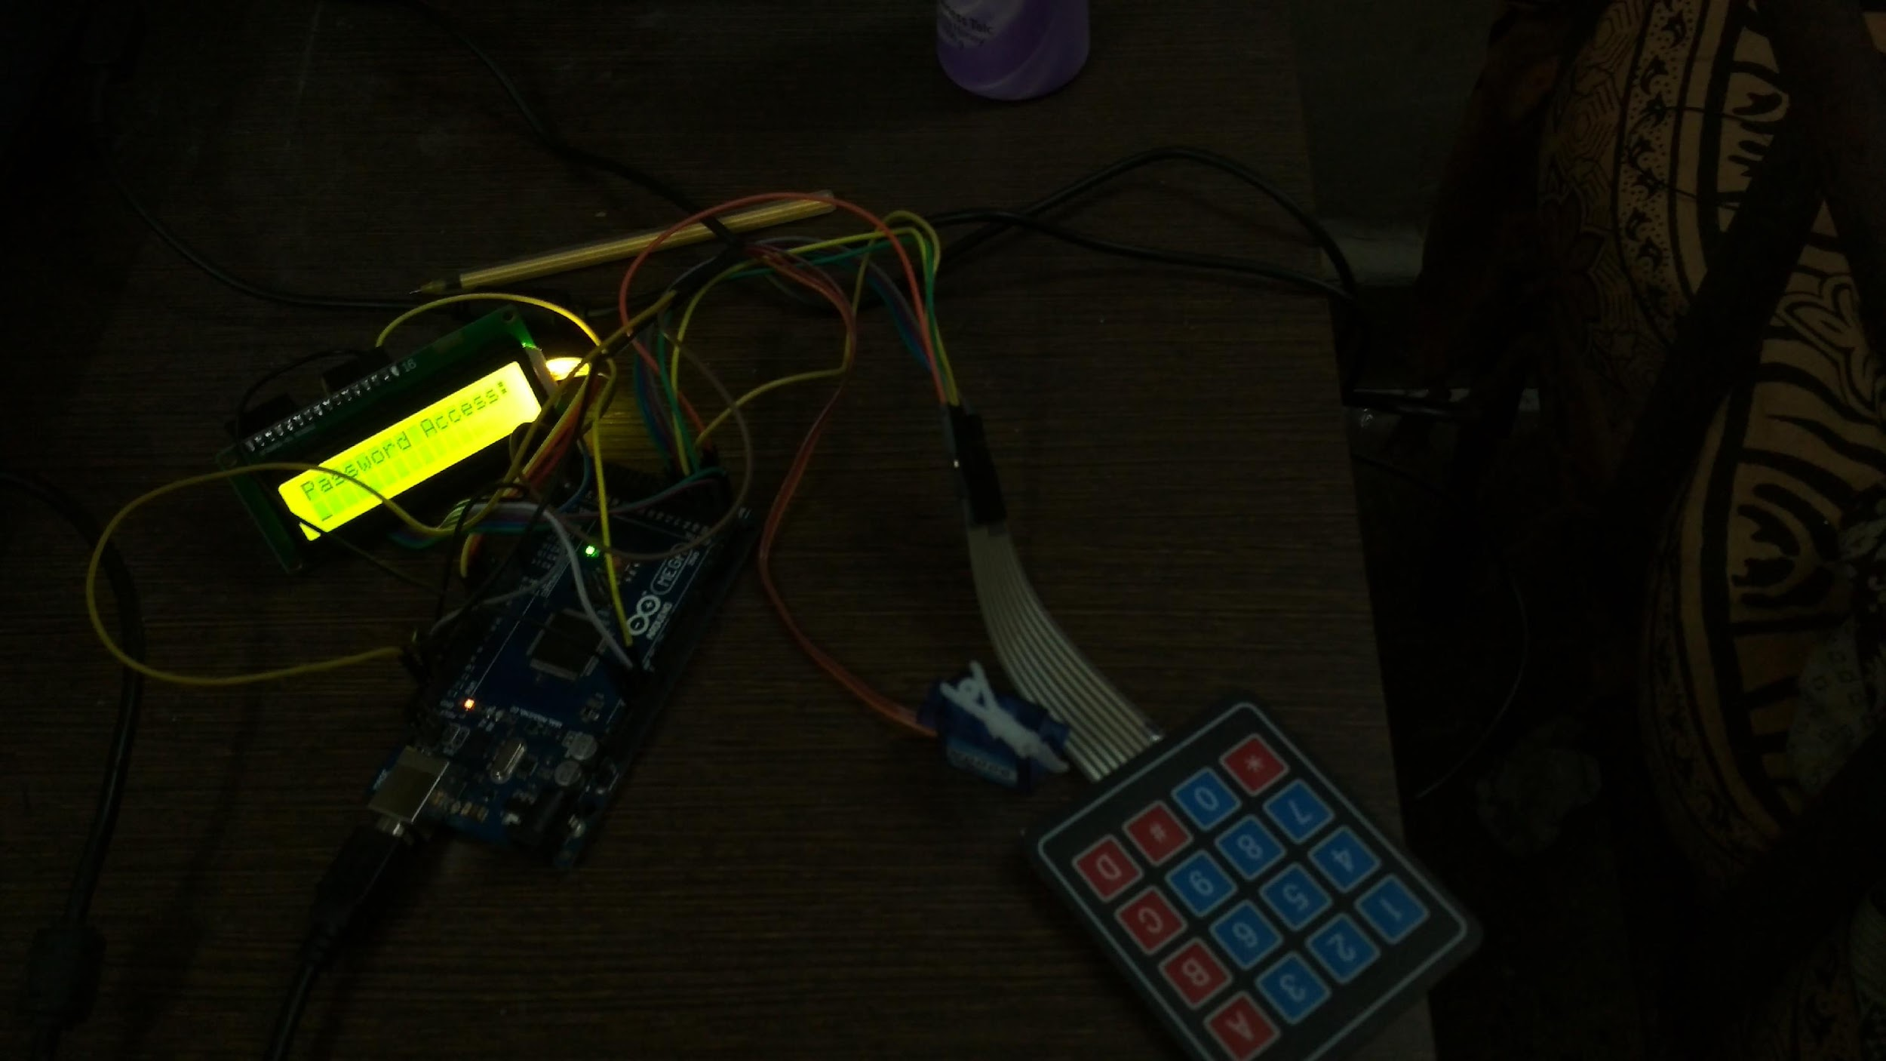
Mini project

Slide 6
Result and Conclusion
If correct password is entered the LCD displays “right password” and access is granted to user
If wrong password is entered the LCD displays “wrong password” and the access is denied

Slide 7
References
Specification of the Bluetooth Core System 1.1, www.bluetooth.org
4. A. Juels RFID security and privacy: A research survey IEEE Journalon chosen areas in Computing, 24(2):381–394, February 2006.
5. https://circuitdigest.com/microcontroller-projects/digital-code-lock-using-arduino
6. circuitdigest.com/fullimage?i=circuitdiagram_mic/Electronic-Code-Lock-Circuit.gif

Slide 8
Thank You

